Slide 1

Genomic Analysis of Trained Intergenerational Resistance to Infections in Mice
Justin Hui, Arham Khan, Vishvak Seenichamy, Sophie Lesher
Team #3
11/24/2021

Slide 2
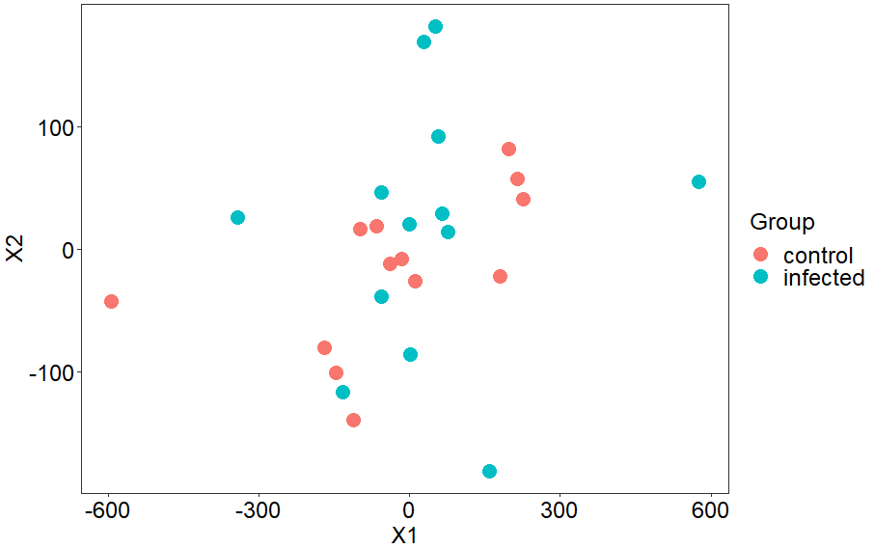
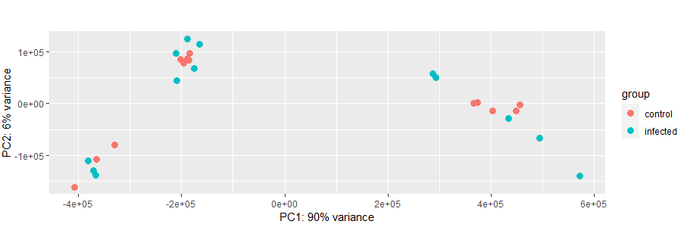
Introduction
Our Dataset: From the Myeloid Cell Biology lab in Germany - mice were infected with a sublethal systemic Candida albicans infection and immune responsiveness was measured.
Our question: Does immunity to a fungal infection in male mice gets passed down to their offspring? (whether infection immunity could be genetically inherited or not).
Two groups: Infected and control groups, alongside their offspring
Measuring: the degree to which infection resistance propagates to the mice’s progeny.
Utilized RNA-seq gene expression data from 26 samples to:
measure differential gene expression between groups
principal component analysis / t-SNE projection

Slide 3
Hypothesis
Do mice demonstrate intergenerational inheritance with respect to infection resistance, when only the paternal mice get infected with C. Albicans?
Research into long-term intergenerational infection resistance is particularly important in 2021
We compared gene expression of common monocyte progenitors cross-generationally in order to arrive at our results
Our Hypothesis:
Based on various articles in other species [1][2][3], we believe that intergenerational inheritance is possible in progeny of mice where only the paternal side is infected with C. Albicans.
[1] https://www.ncbi.nlm.nih.gov/pmc/articles/PMC4240996/
[2] https://www.science.org/doi/10.1126/sciadv.abf3114
[3] https://www.frontiersin.org/articles/10.3389/fimmu.2019.01938/full
Notes:
Resistance to viral and bacterial infections is an important topic especially the last couple years. And research into long-term multi-generation infection resistance is what our question is based on.
We compared gene expression of white blood cell generating genes down several generation of mice to arrive at our results.
Red Flour Beetle, Nemotode, and some primates

Slide 4
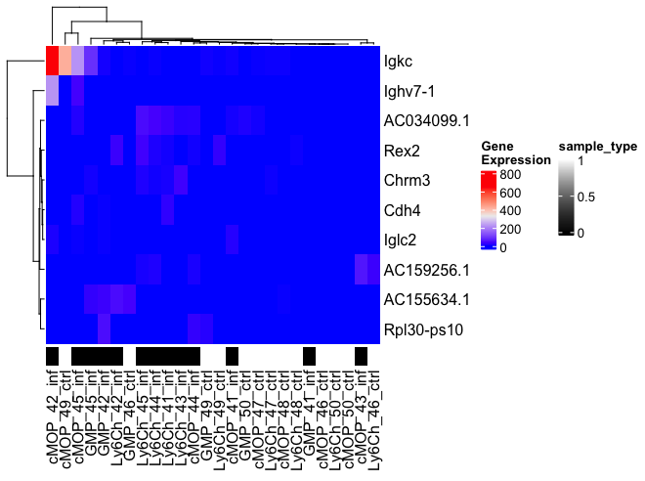
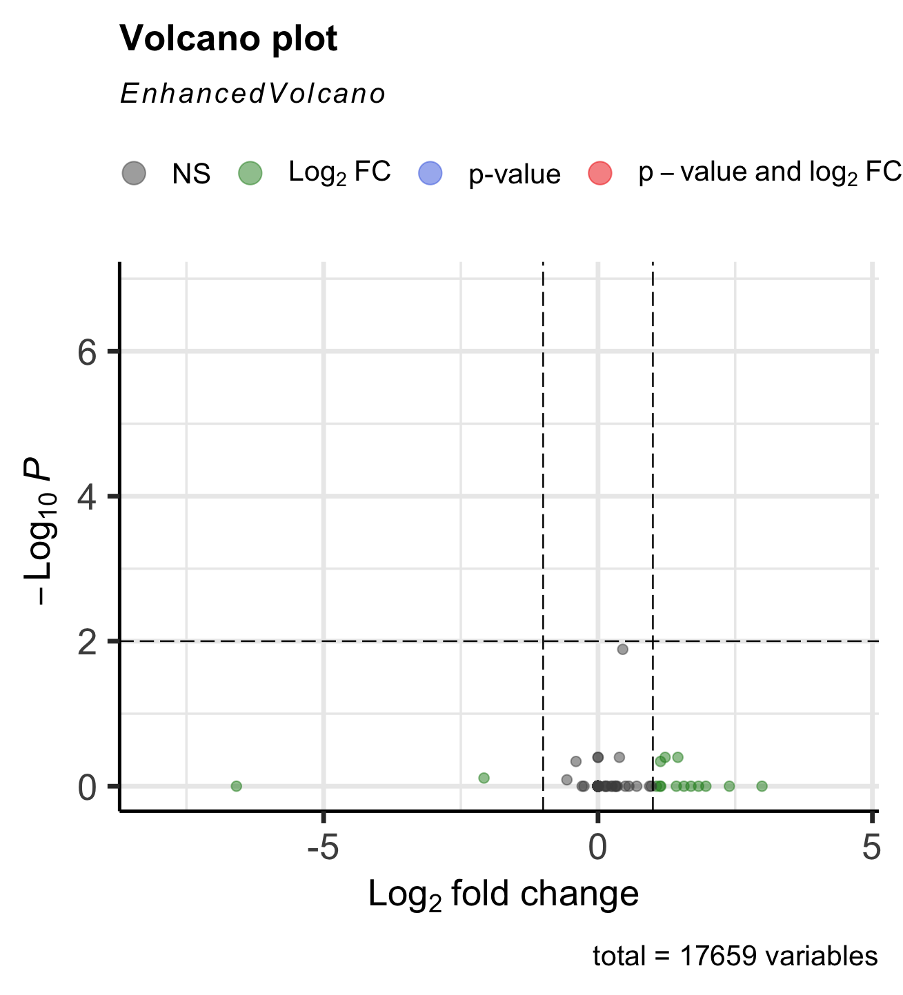
Differential Expression and Enrichment Analysis
ClusterProfiler (Gene Ontology) - 357 enriched observations. These selected genes are of interest and can be used in further experiments to find exact significance in the outcome.
ClusterProfiler (Disease Ontology) - There are no found diseases found from our samples in the clusterProfiler DOSE library. Even when the p-value is increased from .01 to .1 and our minimum value is set to 1, there are still 0 enriched terms found. This may be because our dataset is somewhat unusual and/or underpowered.
gProfiler2 (Gene Ontology) - We found many samples that presented as significant when using a p-value of 0.05 - the default in gProfiler2
TopGO (Gene Ontology) - results appear to match the enrichment analysis of the other gene ontology methods.
Heatmap - The black-colored samples represent the infected group and white-colored for the control group.
Volcano Plot - no data point that was statistically significant.

Slide 5
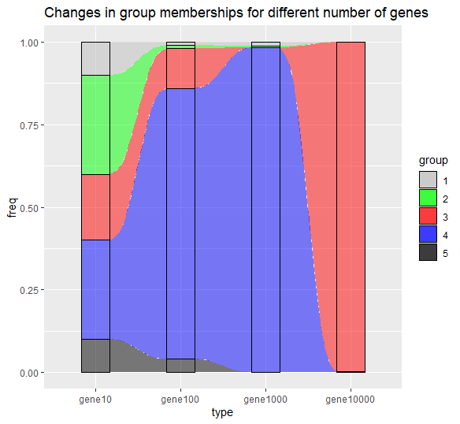
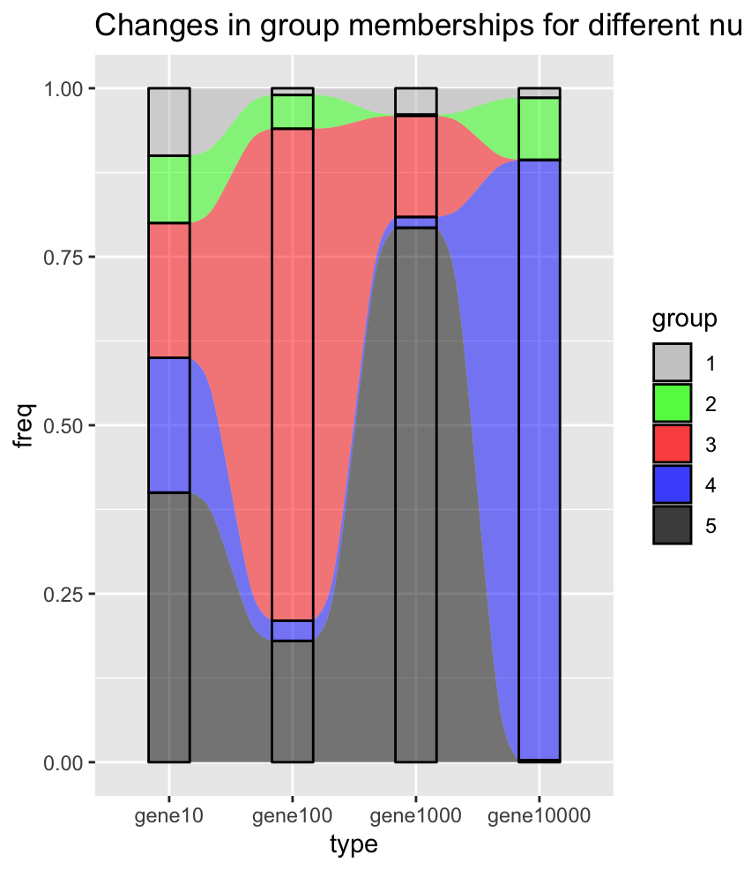
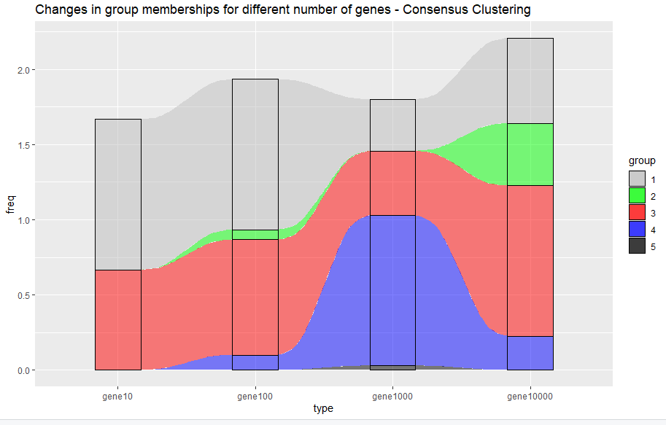
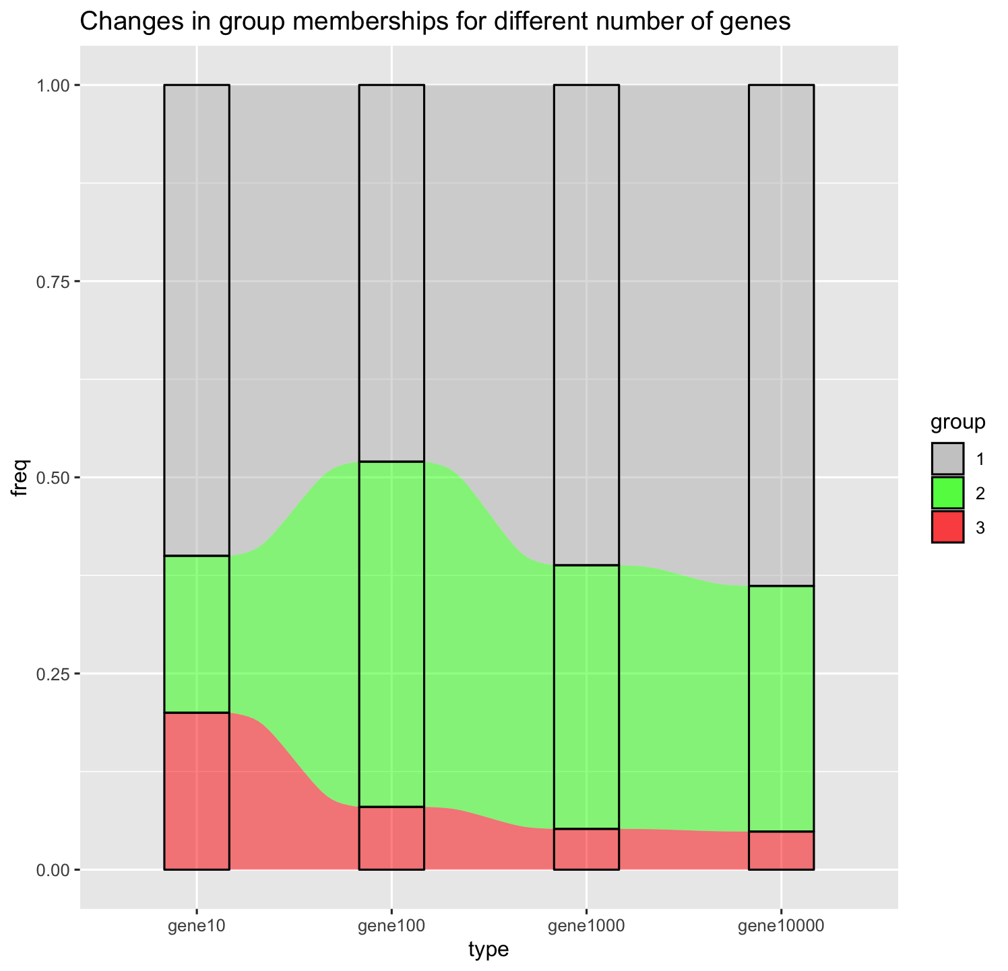
Clustering & Enrichment Analysis
Consensus clustering
Kmeans
Gaussian mixture
Hierarchical Clustering
X-squared = 6.6667, df = 6, p-value = .3528
X-squared = 6.0384, df = 6, p-value = 0.1388
X-squared = 6.3077, df = 5, p-value = 0.2774
X-squared = 6, df = 4, p-value = 0.1991

Slide 6
Conclusions & Future Work
Our original question -
Do mice demonstrate intergenerational inheritance with respect to infection resistance, when only the paternal mice get infected with C. Albicans?
Our hypothesis
Based on various articles in other species [1][2][3], we believe that intergenerational inheritance is possible in progeny of mice where only the paternal side is infected with C. Albicans.
Using our results from our enriched ontology analysis and clustering analysis we conclude that the data supports our hypothesis: mice do demonstrate intergenerational inheritance of infection resistance when exposed to C. Albicans.
Based on our work done thus far, new questions that we propose would be as follows
Does resistance to infection resistance of C. Albicans get passed down to 5 or greater generations?
The progeny of infected mice also show enhanced protection against E. Coli, does this actually get passed down in generations greater than the 3 recorded?

